Slide 1

RUNGTA COLLEGE OF DENTAL SCIENCES & RESEARCH
TITLE OF THE TOPIC: ENDODONTIC EMERGENCY
DEPARTMENT OF CONSERVATIVE DENTISTRY AND ENDODONTICS

Slide 2
Specific learning Objectives
At the end of this presentation the learner is expected to know
Core areas* H | Domain ** | Category #
ENDODONTIC EMERGENCIES, DIAGNOSIS, | Cognitive | Must know
TREATMENT PLANNING, AVULSION, NaOCl accident | Psychomotor | Nice to know
Aapical extrusion of debris | Affective | Desire to know
*Subtopic of importance
** Cognitive, Psychomotor or Affective
# Must know , Nice to know & Desire to know

Slide 3
TABLE OF CONTENTS CONTENTS :
Introduction
Definition
Categories
Differentiation of Emergency and Urgency
System of Diagnosis

Slide 4
Treatment Planning
Pre-treatment Emergencies
Inter-appointment Emergencies
Post-obturation Emergencies
Emergencies related to trauma
Avulsion
Sodium hypochlorite accident
Conclusion
References

Slide 5
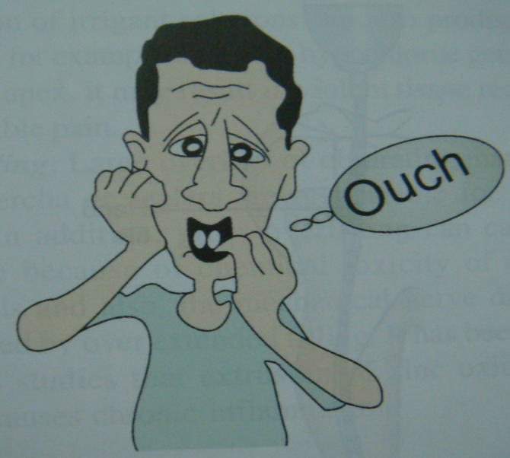
INTRODUCTION

Slide 6
Microbiology & Immunology of flare-ups:
Alteration of local adaption syn
Changes in periapical tissue pressure
Microbial factors
Chemical mediators
Changes in cyclic nucleotides
Immunological responses
Psychological factors

Slide 7
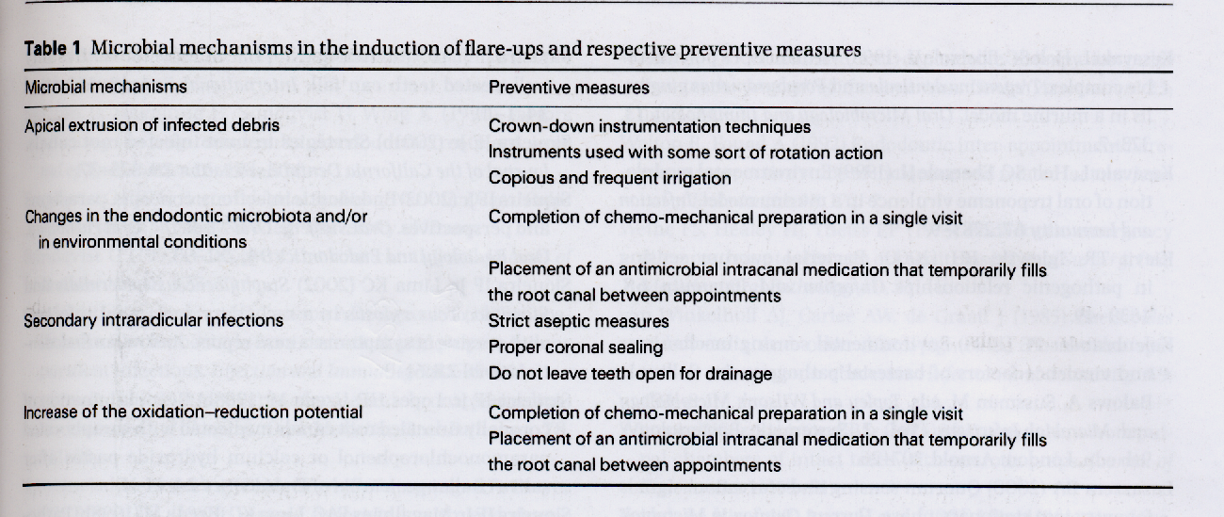

Slide 8
Preventive measures :
Selection of instrumentation techniques that extrude less amounts of debris apically
Completion of the chemo mechanical preparation in a single visit
Use of an anti-microbial intracanal medicament
Not leaving teeth open for drainage
Maintaining the aseptic chain

Slide 9
Management :
Previously vital pulps with complete debridement
P.V.P. With Incomplete debridement
P. Necrotic pulps without swelling
P.N.P with swelling

Slide 10
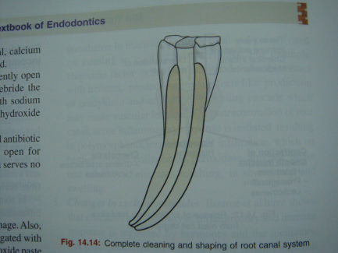

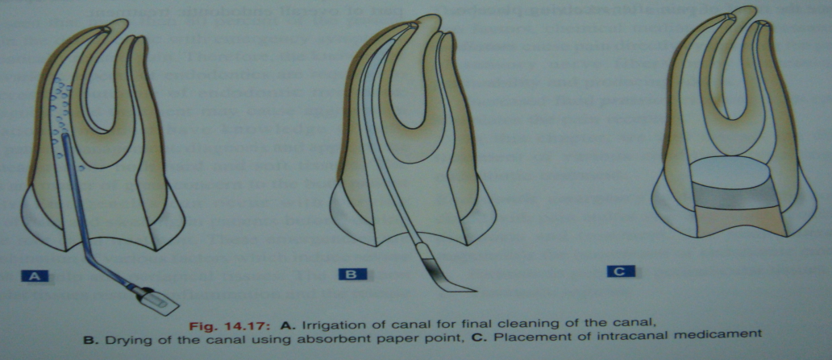
In general:
Reassurance to pt
Complete debridement
Drainage
Occlusion relief
Ca(OH)2 therapy
Intracanal medicament
Medications
Placebo

Slide 11
POST- OBTURATION EMERGENCIES :
Etiology :
Over instrumentation
Over filling
Persistant periapical inflammation
Missed canal
Fracture
Hyperocclusion
Poor coronal seal

Slide 12
Treatment :
Reassurance of the pt
Prescribe analgesics
Check occlusion
Don’t retreat randomly

Slide 13
EMERGENCY TREATMENT OF TRAUMATIC INJURIES-FRACTURES
Crown fracture
without pulp exposure
with pulp exposure
with necrotic pulp exposure
Horizontal root fracture
Avulsed teeth

Slide 14
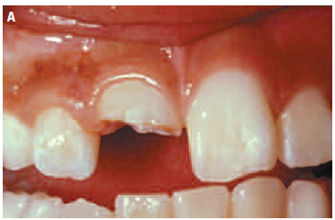
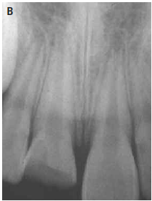
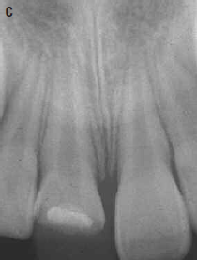
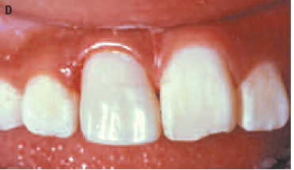
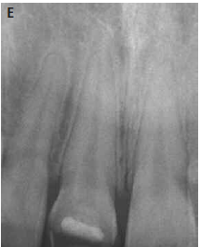
Crown fracture with vital pulp exposure

Slide 15
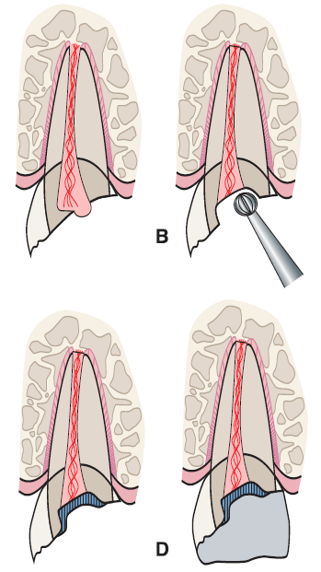
Shallow pulpotomy
A, Crown fracture exposes pulp.
B, Remove pulp tissue with a round diamond bur to a depth of about 2 mm;
C, After bleeding has stopped, wash the pulp wound
with saline and apply calcium hydroxide liner, on top of which a base must be placed.
D, The lost tooth structure is
replaced with acid-etched composite resin.

Slide 16
Crown fracture with necrotic pulp exposure :
Earlier accident
Caries
Deep restoration
Severing of pulpal vessels

Slide 17
ROOT FRACTURES :
2-phase procedure
1. As soon as possible, reposition the coronal segment of the tooth and stabilize - non-rigid splint for 4 to 6 weeks.
2. Monitor the progress of healing and consider RCT only if there is evidence of pulp necrosis

Slide 18
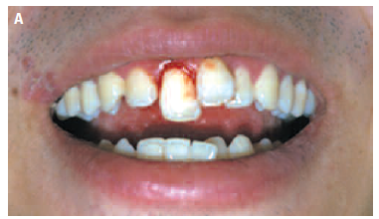
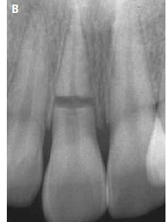
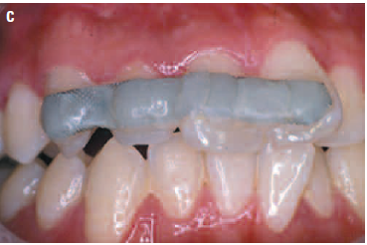
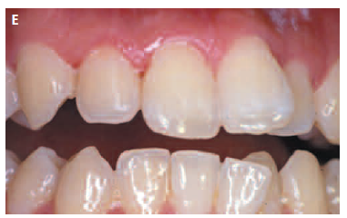
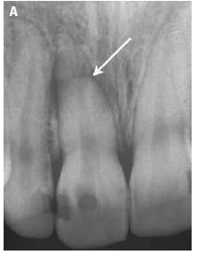
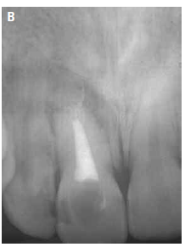
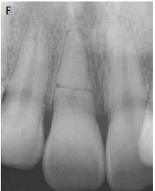

Slide 19
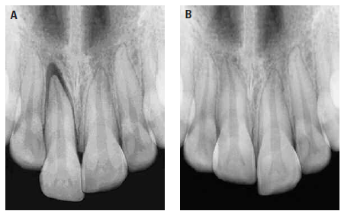
LUXATIONS :
A, Extrusive luxation results in displacement out of the alveolar socket.
B, Intrusive luxation forces the tooth against the bony wall, resulting in a disappearance of PDL space

Slide 20
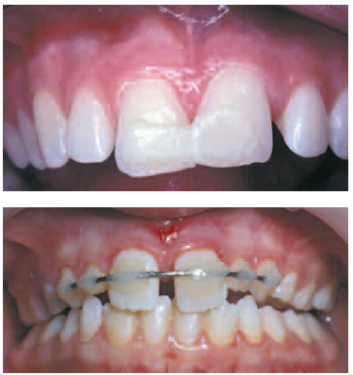
Treatment of luxated teeth consists of
repositioning the tooth, if necessary;
stabilizing the tooth, if it is mobile, to promote PDL
repair;
(3) providing endodontic treatment - undergoes necrosis
Bond unfilled resin to
small, etched areas of the teeth. Avoid etching interproximally.
If there is a space between the teeth, a thin wire can be used to bridge the gap

Slide 21
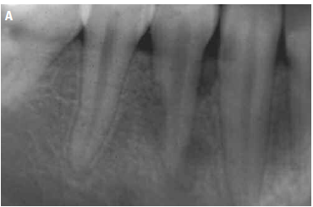
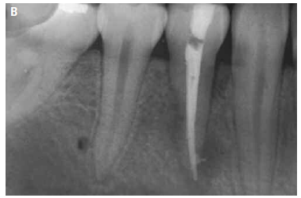
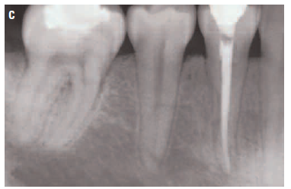
Infection-related (inflammatory) resorption

Slide 22
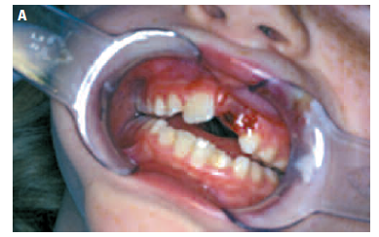
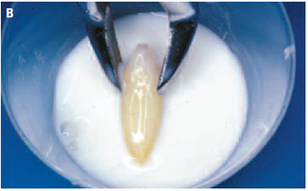
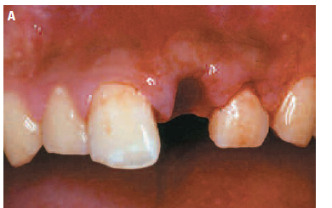
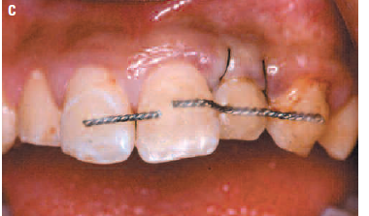
AVULSION :

Slide 23
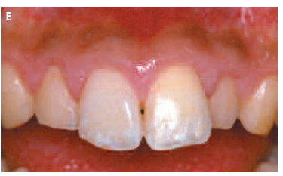
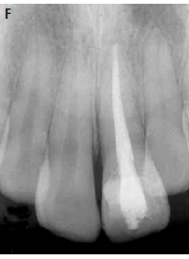
Replantation of an avulsed tooth after the removal of
the splint, about 2 weeks postreplantation.
Follow-up radiograph after root canal treatment and coronal restoration

Slide 24
Emergency treatment at the site of injury
Emergency treatment at the dental office
Completion of endodontic treatment

Slide 25
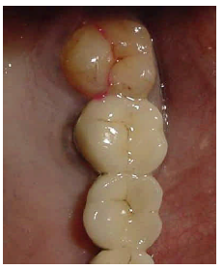
CRACKED TOOTH SYNDROME :
CLASSIC SIGNS, CLASSIC CONFUSION
Elicit erratic pain on mastication, especially with release of biting pressure and/or pain to extremes of temperature, especially cold.
Generally, there is no pain to percussion
Radiographs are inconclusive

Slide 26
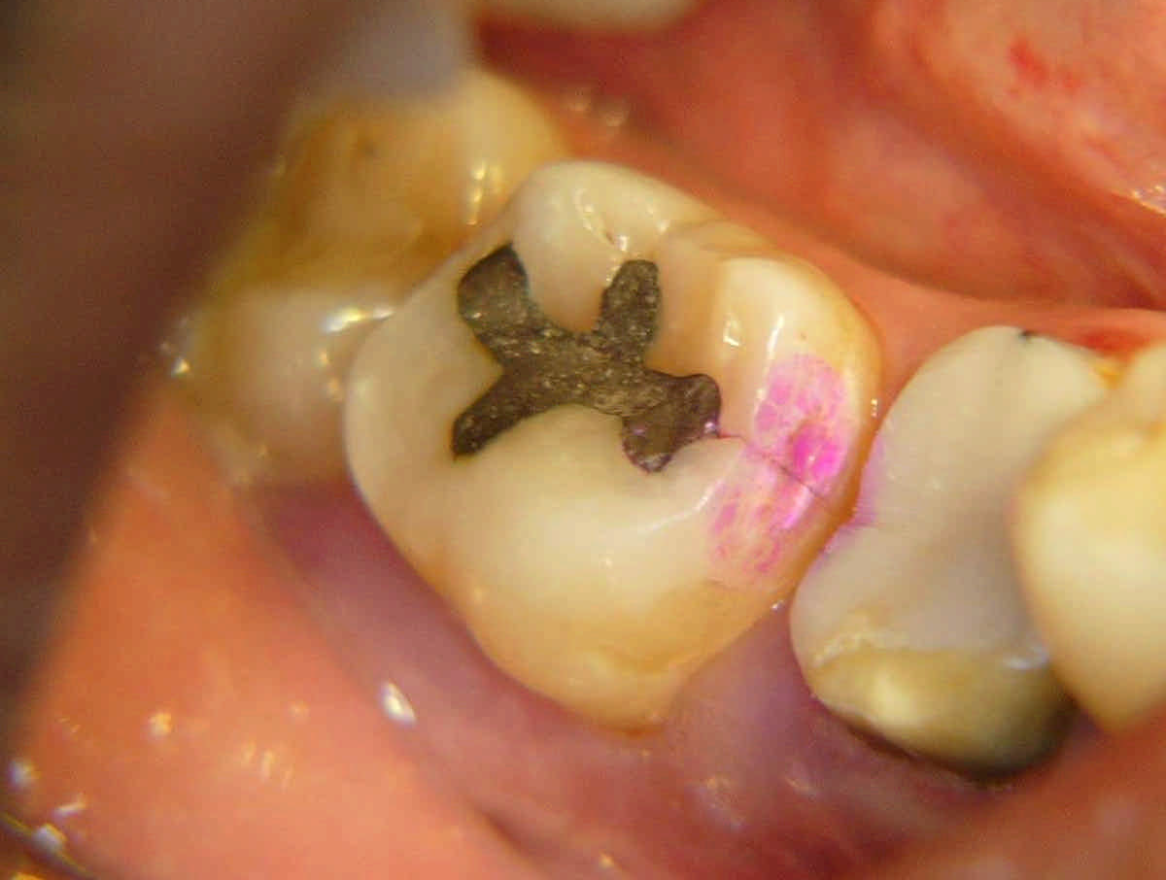
Class A - Crack involving Enamel and Dentin but NOT involving pulp
treated by removing the affected cusp and restoring the tooth with a full crown that covers the crack margin.

Slide 27
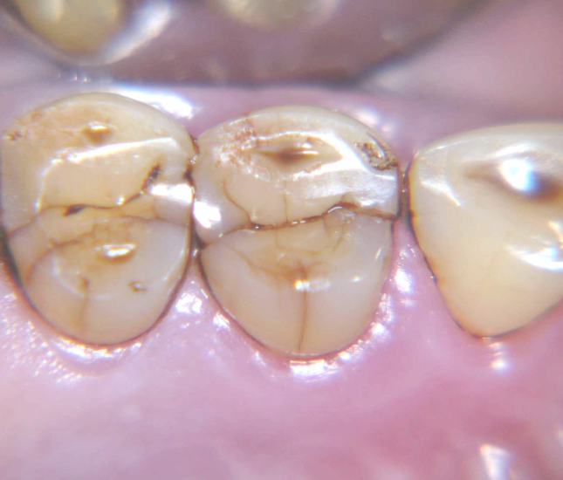
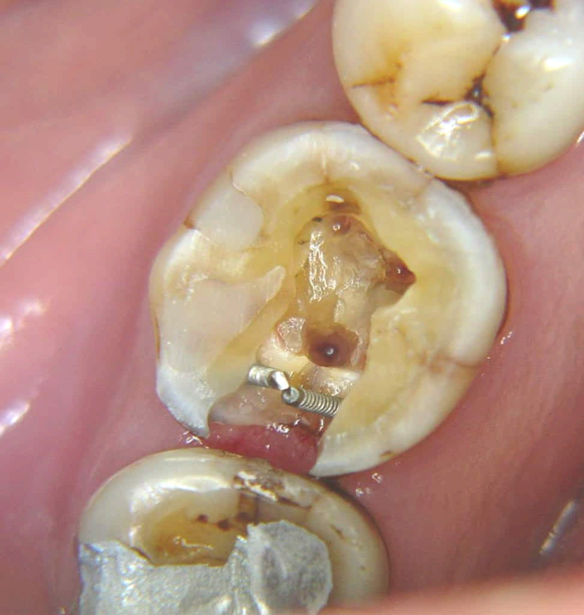
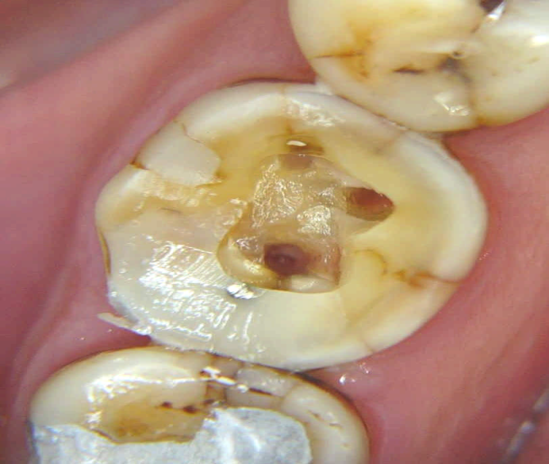
Class B
Incomplete fracture of crown extending to the pulp not involving periodontal apparatus
If pain on chewing is the only symptom, a tight-fitting band or temporary crown
A full coverage restoration may keep the tooth pain free
Any thermal sensitivity - pulp involvement, RCT- prior to restoring the tooth with a crown
dentinal pins placed and area bonded with resin restorative material after identifying the canals but before biomechanical preparation and obturation
class B crack

Slide 28
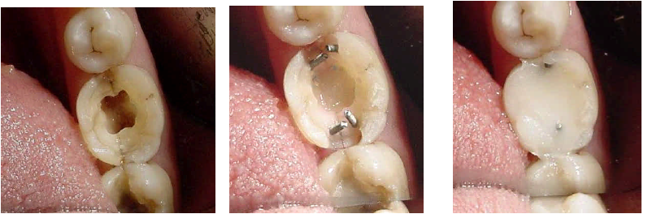
class C
Incomplete fracture of crown extending to the pulp and
involving periodontal apparatus
after endodontic therapy and restorative management
with final restoration.
A crown will be placed after clinical and radiological
evidence of improved periodontal status.

Slide 29
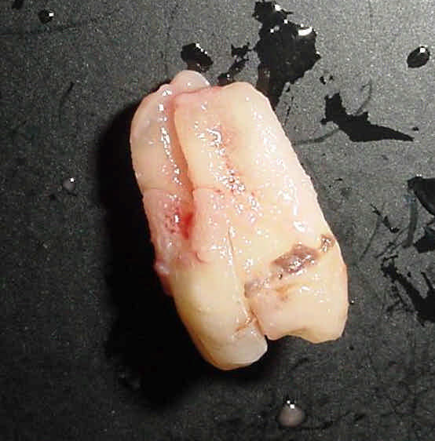
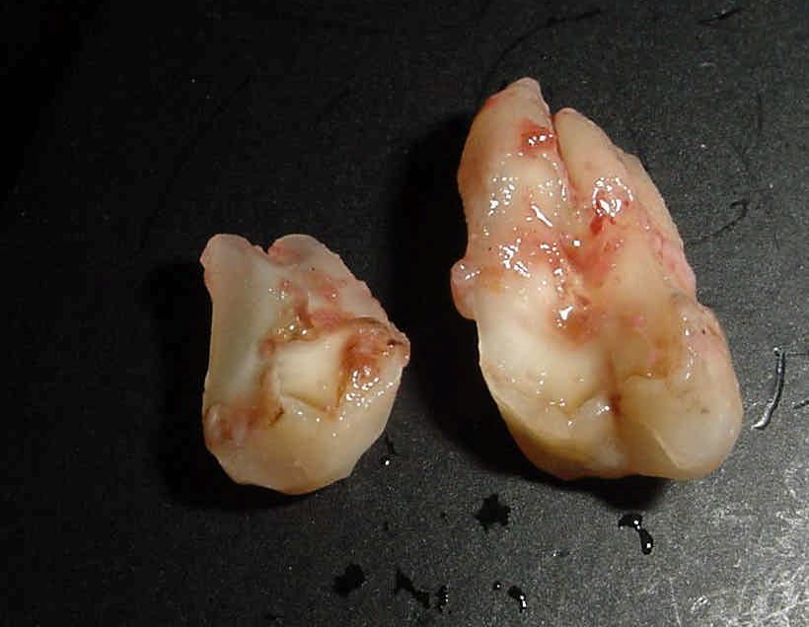
Class D
SPLIT TOOTH
the smaller fractured segment ,removed and the
remaining segment restored.
If the crack extends apically to a significant extent -extraction

Slide 30
Class E
VERTICAL ROOT FRACTURE [VRF]
surgical inspection for conclusive diagnosis.
a “punched-out” oblong bony defect
filled with granulomatous tissue overlying the root
Depending on the type of tooth affected, treatment may involve
extraction,
root resection or
hemisection

Slide 31
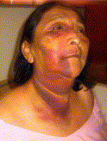
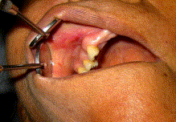
SODIUM HYPOCHLORITE ACCIDENT :

Slide 32
Symptomatology
Immediate severe pain & burning sensation
Immediate oedema of neighbouring soft tissues
Profuse bleeding from the root canal
ecchymosis
Chlorine taste and irritation of the throat
Secondary infection possible
Reversible anaesthesia or paraesthesia possible

Slide 33
Therapy
Patient information on cause and severity of complication
Pain control: local anaesthesia, analgesics
In severe cases: referral to a hospital
Extraoral cold compresses for reduction of swelling
After 1 day: warm compresses and frequent warm mouthrinses for stimulation of local systemic circulation
Daily recall for control of recovery

Slide 34
Antibiotics: Only in cases of high risk or evidence of secondary infection
Antihistamine: not obligatory
Corticosteroids: controversial
Further endodontic therapy with sterile saline or chlorhexidine as root canal irrigants

Slide 35
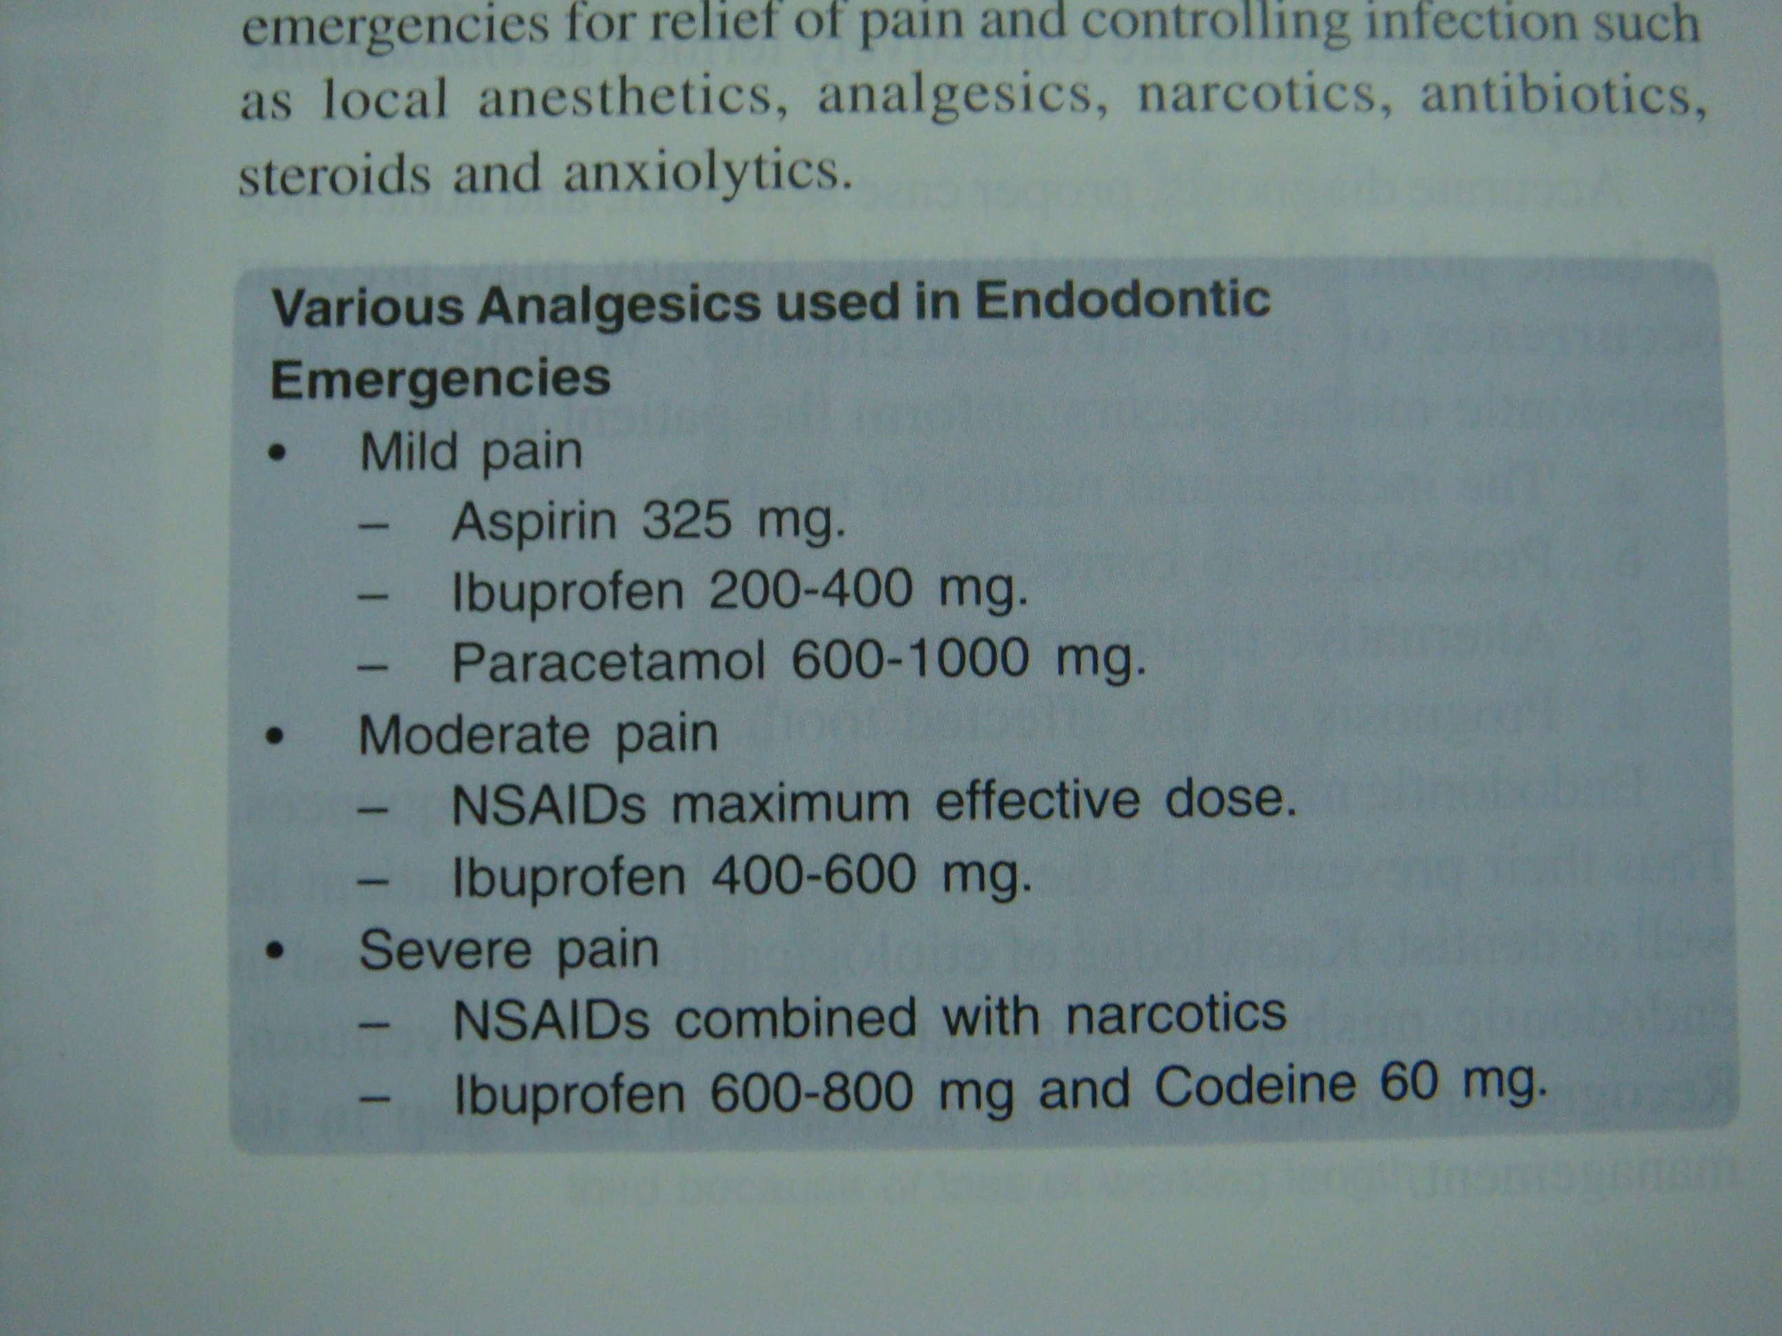

Slide 36
Teaching Materials
Endodontic practices - Grossman
Pathways of pulp – Cohen
Textbook of Endodontics – Nisha Garg
Endodontics - Ingle

Slide 37
TAKE HOME MESSEGE/ FOR THE TOPIC COVERED (SUMMARY)
Endodontic emergencies are a challenge for both diagnosis and management.
Knowledge and skill in several aspects of endodontics are required;failure to apply these will result in serious consequences for the patient
It is satisfying and rewarding to successfully manage a distraught patient who has an emergency.

Slide 38
Question & Answer Session
1. How will you manage a hot tooth in dental clinic?
2. What are pretreatment endodontic emergencies. Discuss their management?

Slide 39
REFERENCES
Endodontic therapy- Franklin.S.Weine(sixth edition)
Principles and practice of endodontics-Walton, Torabinejad (4th Edition )
Traumatized teeth – Mitsuhiro Tsukiboshi
Iej-36,453-463,2003
Iej-38,843-848,2005
Oooe, vol.108, issue 1, July 2009, e46-e49
J Can Dent Assoc 2001; 67:391-7
J Am Dent Assoc, 2000, Vol 131, No 1, 67-71

Slide 40

THANK YOU

